Slide 1
In-DB Data Science
& Machine Learning
Pranjal Singh
Data Science Solutions Architect

Slide 2
Machine Learning (ML) is built into the core of Vertica
Deliver predictive analytics at speed and scale
Node₁
Node₂
Node_{n}
Tree₁
Tree₂
Tree₃
Tree₄
Tree_{2n-1}
Tree_{2n}
MPP architecture is a great fit – ML functions run in parallel across hundreds of nodes in a Vertica cluster
Notes:
Vertica was designed for Machine learning and Advanced Analytics.
Our MPP Architecture means all queries and functions are run in parallel across nodes.
This means you get results and predictions faster.
While Spark can scale out and add more nodes, it needs more nodes than Vertica to get the same performance. For example, one recent customer I worked with had a 100-node spark cluster for geospatial workflow. With Vertica, we only needed 6 nodes to match performance.
Spark: Data is loaded into memory, with Vertica, the algorithm is in memory with the data is on disk

Slide 3
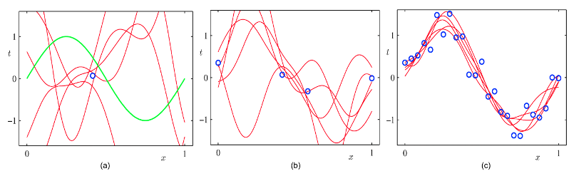
Sampling vs. full data set
Data usually matters more than algorithms for complex problems
Small data sets usually lack generalization and are prone to over-fitting
Large data results in better generalization
Source: https://towardsdatascience.com/breaking-the-curse-of-small-datasets-in-machine-learning-part-1-36f28b0c044d
Notes:
We are bringing ML To the data, not vice versa. Since not exporting peta bytes, we can use the full dataset! Because of this, our models are more accurate, as there is less variance.

Slide 4
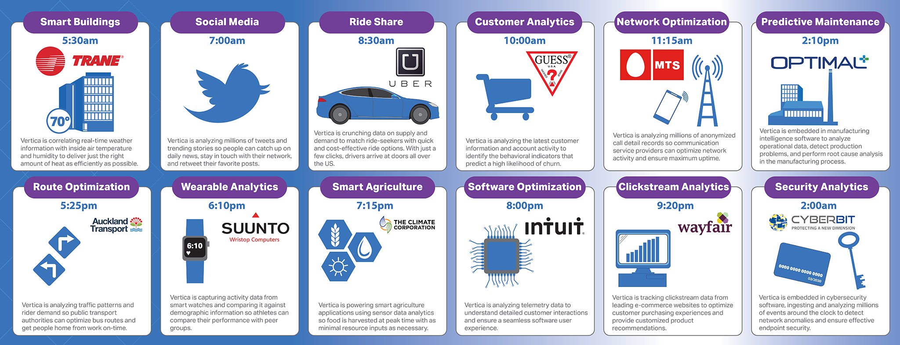
Data Driven companies rely on Vertica for their business
Notes:
Across every industry and use case, successful Data Disruptors all have one thing in common – Vertica!

Slide 5

Supporting the Entire Data Science Process
SQL-BASED IN-DATABASE ML WORKFLOW
Capture
Measure
Prepare
Train
Evaluate
Deploy
Avro, CEF, CSV, JSON, RegExp
Statistical Summary
Outlier Detection
SVM
Model-level Stats
In-Database Scoring
Shapefiles & Spatial Data
Time Series
Normalization
Random Forests
ROC Tables
Speed
External Tables
Pattern Matching
Imbalanced
Data Processing
Logistic/Linear Regression
Error Rate
Scale
ORC, Parquet, HIVE, Spark
Window / Partition
Sampling
Naive Bayes
Lift Table
Security
Kafka
Sequences
Missing Value Imputation
K-Means Clustering
Confusion Matrix
Import/Export
S3, HDFS
Sessionization
One Hot Encoding
Your Model Here
R, Python, Java, C++
R-Squared & MSE
Visualize
5
Notes:
SQL Engine under the covers The whole process can be completed through our own SQL Editor, Management Console, or your own SQL Editor like DBViz, or use our VerticaPy library

Slide 6





Vertica is not just a simple Data Warehouse
ODBC/JDBC
SELECT IMPUTE
SELECT NORMALIZE
SELECT RF_CLASSIFIER
SELECT ROC
User Defined Functions
Notes:
User Defined Functions are functions customized by you in one of the four available programming language (C++, Python, Java or R). So why not starting to build your Data Science playground?

Slide 7

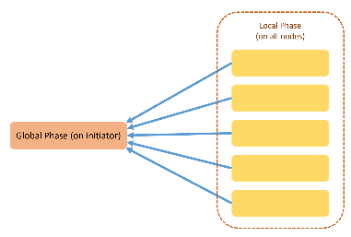

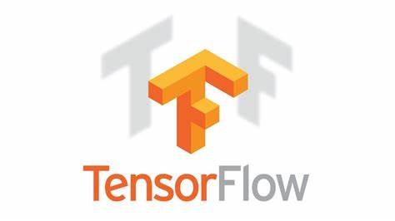

Vertica machine learning
erticaPy
SQL front-end
Python API
Build your own model
UDx
BRING your own model TF
Import & Export model PMML
Notes:
Integration with popular platforms, tools and algorithms to continue our commitment to an open ecosystem

Slide 8
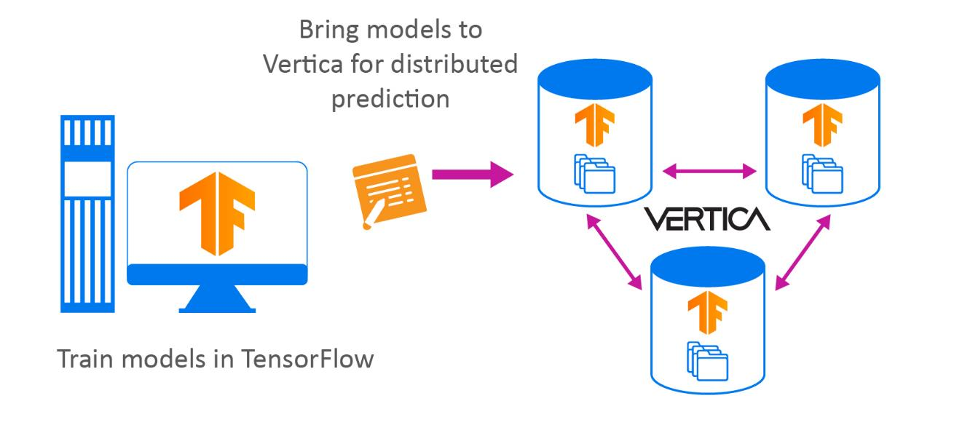
Model import from TensorFlow
Bring advanced Machine Learning and Neural Network models to Vertica
BENEFITS
Can integrate with production system
Low-impact
Prediction is not processor intensive
Cheaper
Parallelized
No extra data movement
Model management in Vertica
Results are where you need them
TensorFlow models get copied to all nodes
Prediction happens in a distributed fashion in the database
Different batches of data are processed simultaneously
Result: Extremely fast prediction

Slide 9
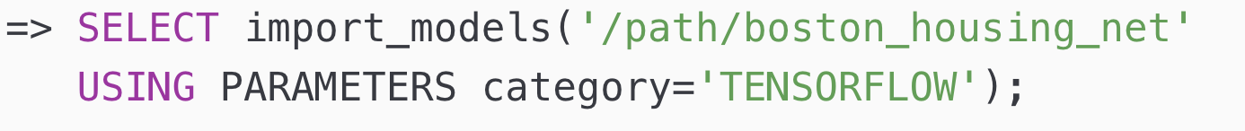
TensorFlow model import
Steps for model import
Train neural network
Save the model in TensorFlow’s ‘frozen graph’ format
Create JSON file describing inputs/outputs of model
Put both files in a directory on a node in a Vertica cluster
Import directory into Vertica
Notes:
Make flow chart
Maybe even put in separate slides with images/screenshots/etc
reduce text
Check if num_passthru_cols is required

Slide 10
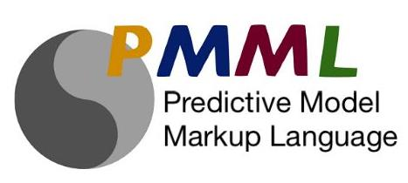
Model Import and Export using PMML
Vertica further embraces the ecosystem of data science tools
Model import
Build Machine Learning models in the tool of your choice (Python, R, Spark, ….)
Bring models to Vertica for archiving and predictions on your hot data
After import models are treated just like Vertica in-db models
Example: If a customer has already built a Logistic Regression model for consumer churn using Python, they can simply import that into Vertica and make predictions on the data in Vertica
Model export
Build Machine Learning models in Vertica on large data sets
Export models in a format understood by many tools in the market
Example: Build a Linear Regression model using large amounts of data available in Vertica database and then export it to an edge node to make predictions on live streaming data

Slide 11





Welcome to VerticaPy
Python
SQL
BI
ML
Python Front-End
SQL Back-End
Rendering Capabilities
Data Science Lab
Python objects which expose scikit/pandas-like functionnality
All the heavy computations are pushed to Vertica
Offers multiple rendering capabilities
Possibility to follow the entire Data Science cycle without moving the data

Slide 12
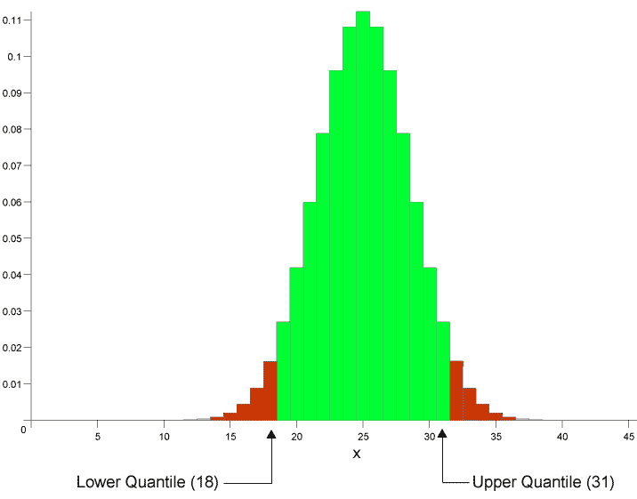



Evolved functionality of Vertica’s ML offering
Time series forecasting
Graphs & visualizations
Additional algorithms
Jupyter notebooks
Integrate with external ML ecosystem
Expand library of in-database functions
Analytics/ML functions
Enhance model management
User- defined models
Model import and export,
Model versioning,
Pipelining,
Model performance monitoring
Model scheduling,
Filtering and searching,
Comparing models
Model exchange & Model management

Slide 13
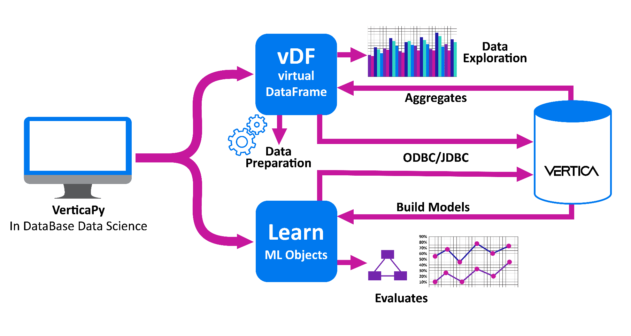
VerticaPy
https://www.vertica.com/python/
https://github.com/vertica/VerticaPy
Python API for Analytics and Machine Learning at Scale
BENEFITS
Jupyter/Python – popular tool of choice for data scientists & analysts
Graphs and visualizations
Data stays in Vertica (security, integrity, scalability)
Much of the heavy computation is done by Vertica
Open source – users can contribute
Model storage & management in Vertica
Results are where you need them for BI, applications and ad-hoc queries
vertica-python or ODBC/JDBC
Python Front-end & SQL Back-end
13
Notes:
13

Slide 14

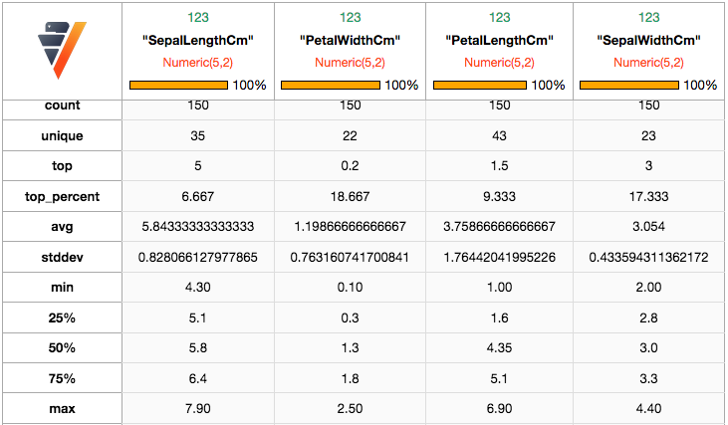

Example – Summary Statistics
https://www.vertica.com/python/
https://github.com/vertica/VerticaPy
Client
from verticapy import vDataframe
# Object Creation
vdf = vDataframe("public.iris", dsn = "VerticaDSN")
# Describe
vdf.describe()
SELECT SUMMARIZE_NUMCOL("SepalLengthCm",
"PetalWidthCm",
"PetalLengthCm",
"SepalWidthCm")
OVER () FROM "public"."iris"
Output
Distributed Execution
VerticaPy
In Database Data Science
Notes:
14

Slide 15

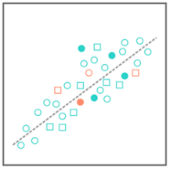
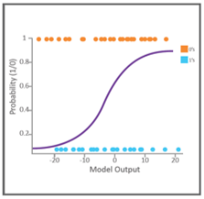
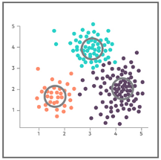
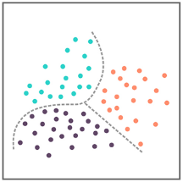
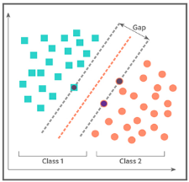
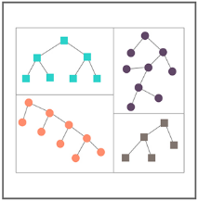

Vertica ML algorithms – available today, built to scale
Linear regression
Logistic regression
K-means
Forecast sales revenues
Predict customer retention
Customer segmentation
Naive Bayes
SVM
Random Forest
Classify gene expression data
for drug discovery
Predict sensor failure
Refine keywords to improve Click Through Rate (CTR)

Slide 16
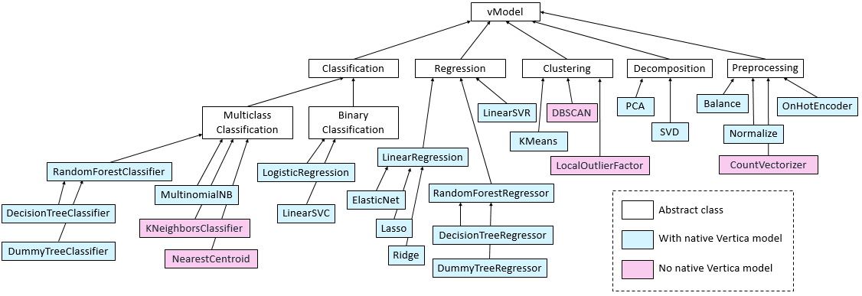
Vertica ML algorithms
Model training, prediction and evaluation supported for each algorithm

Slide 17
Vertica Model Management
List Models
SELECT * FROM models;
schema_name
model_owner
model_name
model_type
model_size
public
dbadmin
linearRegModel
linear regression
399
public
dbadmin
logisticRegModel
logistic regression
780
public
dbadmin
myKmeansModel
kmeans
845
Summarize Models
SELECT Summarize_Model('LogisticRegModel');
Change Model Name, Owner and Schema
ALTER MODEL mymodel RENAME to mykmeansmodel;
ALTER MODEL mykmeansmodel OWNER TO user1;
ALTER MODEL mykmeansmodel SET SCHEMA public;
Delete Models
DROP MODEL myLinearModel;

Slide 18
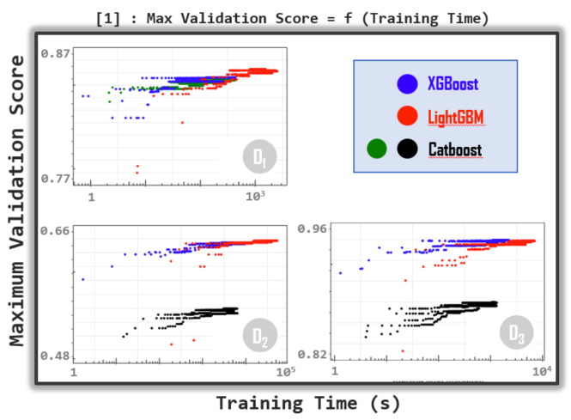
Lightweight
Expressive
Interpretable
Fast
Kaggle Survey 2019: Gradient Boosting (XGBoost, LightGBM, CatBoost ...)
= 3rd most common ML algorithm, behind Lin/Log Regressions and Decision Trees.
[1] Anghel et al., Benchmarking and Optimization of Gradient Boosting Decision Tree Algorithms, IBM Research, Jan 2019

Slide 19
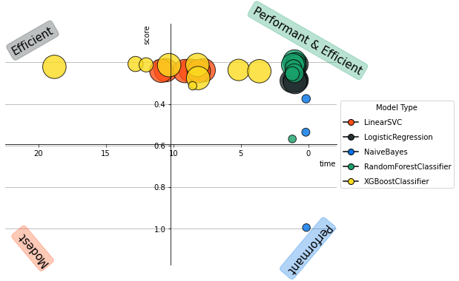
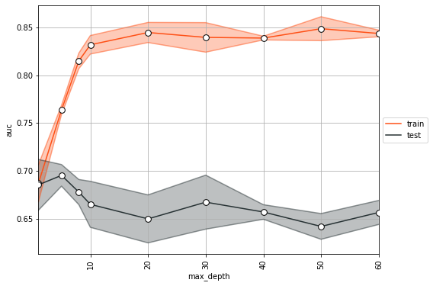
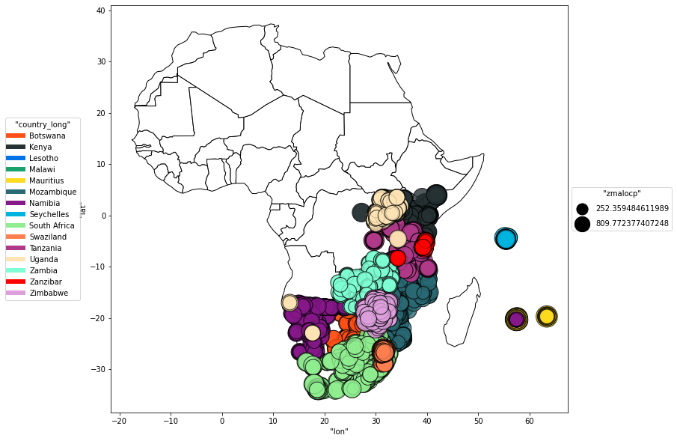
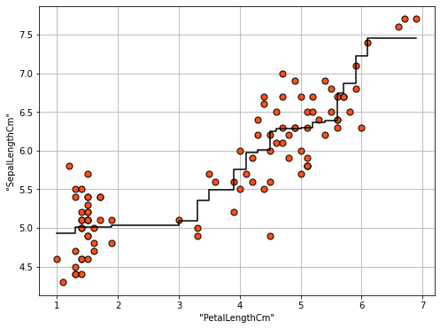
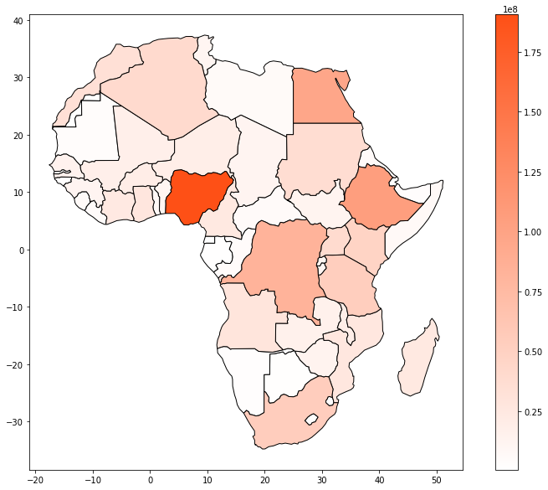
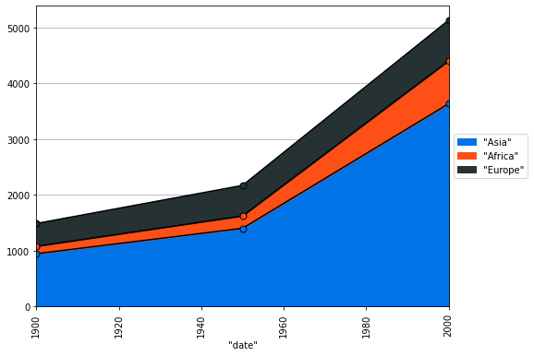
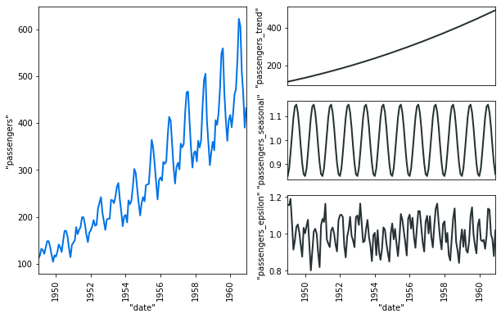
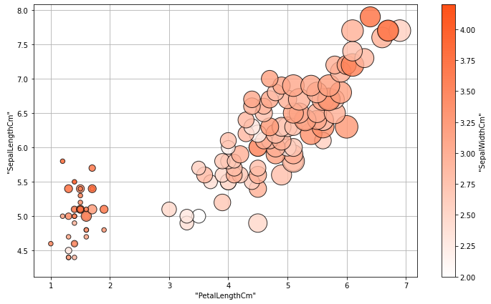
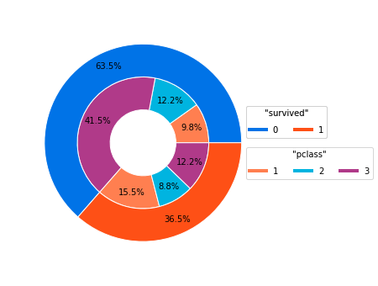
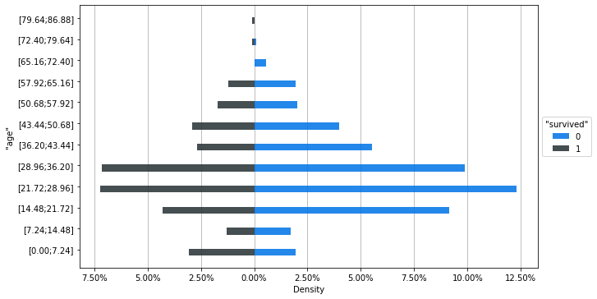
Welcome to VerticaPy 0.6.0
AutoML
Geospatial
Grid Search
Seasonal Decomposition
More Charts

Slide 20

DEMO

